Slide 1
Enhanced the security of lsb based text and image steganography using aes techniques
TEAM MEMBERS:
M.Abirami-19TD0501
S.Nagarethinam-19TD0514
K.Subastri-19TD0519
GUIDED BY,
Dr. J. Udayakumar

Slide 2
agenta
Abstract
Aim and Scope of the Project
Introduction
Literature Survey
Proposed Work
Metrics Used
Experimental Results
Applications
Advantages
Disadvantages
Conclusion
Future Work
References

Slide 3
abstract
The main objective of this project is to hide the secret message inside the image using Least Significant Bit (LSB) technique and provide security for the hidden message using Advanced Encryption Standard (AES) Algorithm. Additionally the for transferring the key the Diffie Hellman’s key exchange technique is used to share the key to the receiver securely.

Slide 4
Aim and scope of the project
The aim of the project is to increase the security in communication by hiding the message in a cover image such a way that the secret message is not visible to the observer.
The goal of this project is to avoid drawing suspicion to the existence of a hidden message.
The scope of the project is to limit unauthorized access and provide better security during message transmission over a network. To meet the requirements we use simple and basic algorithms.

Slide 5
INTRODUCTION
INFORMATION SECURITY :
It is the practice of protecting information by mitigating information risks. It involves the protection of information systems and the information processed, stored and transmitted by these systems from unauthorized access, use, disclosure, disruption, modification or destruction.
STEGANOGRAPHY :
It is the technique of hiding secret data or message within an ordinary, non-secret, file in order to avoid detection, the secret data is then extracted at its destination. Image steganography is a technique used to hide secret data or message within an image and it is combined with encryption as an extra step for hiding or protecting data.

Slide 6
Cont’d
COVER IMAGE & STEGO-IMAGE :
The image chosen for the process of concealing data within a image file is referred to as the cover image and the image that contains secret message is known as stego-image.
LEAST SIGNIFICANT BIT (LSB) :
One of the simplest methods of the concept of Steganography is the Least Significant Bit. The Least Significant Bit (LSB) method hides the message by inserting the message at the lower or rightmost bits in the cover work file as a medium to hide the message.
ADVANCED ENCRYPTION STANDARD (AES) :
The AES algorithm is the symmetric algorithm that is secure enough to provide security for confidential data operating on plaintext of 128- bit with variable key length of 128, 192 and 256-bit .

Slide 7
Literature survey
PAPER 1 : “A Novel Steganography Technique for Digital Images Using the Least Significant Bit Substitution Method” , Shahid Rahman, Jamal Uddin et al, 2022.
WORK DONE :This paper suggests a new method called Least Significant Bit (LSB) substitution for hiding information within digital images such as RGB, Gray Scale, Texture, and Aerial images. The goal of this technique is to improve the security, invisibility, capacity, and strength of steganography compared to current methods.
MERITS :
Simplicity and ease of implementation.
Low visual impact.
High embedding capacity
DEMERITS :
Sensitivity to image processing.
Incompatibility with certain image formats.

Slide 8
Cont’d
PAPER 2 : “A Secure Image Steganography using LSB and Double XOR Operations”, Ali Ahmed and Abdelmotalib Ahmed, May 2020.
WORK DONE : In this paper, the researchers suggest a method that involves two layers of encryption and hiding stages. First, the message is encrypted using a secret key and double XOR operations in binary form. Then, the encrypted message is hidden within the cover image using the LSB technique. To make sure their method is reliable, they calculated well-known evaluation measures such as MSE, PSNR, Entropy, and histogram distribution.
MERITS :
Resistance against statistical analysis.
Improved robustness against image processing.
Increased resistance against steganalysis techniques.
DEMERITS :
Complexity and implementation challenges.
Vulnerability to steganalysis techniques.

Slide 9
Cont’d
PAPER 3 : “Data hiding in image using lsb with des cryptography”, Krati Yadav and Swapnil Rajput, 2016.
WORK DONE : This paper talks about a method that uses the least significant bit (LSB) and a new encryption algorithm. By aligning the data with an image, it reduces the risk of an attacker using steg analysis to retrieve the data. Before hiding the data in an image, the application encrypts it.
MERITS :
Robust against cryptographic attacks.
Enhanced confidentiality.
Enhanced confidentiality.
DEMERITS :
Dependency on the encryption algorithm.
PerfAormance overhead.

Slide 10
Cont’d
PAPER 4 : “Image Steganography based Cryptography”, Jemima Dias, Dr. Ajit Danti,2020
WORK DONE : In this paper, the image encryption and decryption method has been proposed where the secret image gets encrypted carefully into the cover image using the NET, based on using XOR operation between two images using the weights present within the network.
MERITS :
Dual protection.
Resistance to brute-force attacks.
Seamless integration.
DEMERITS :
Sensitivity to initial conditions.
Lack of cryptographic strength.

Slide 11
Cont’d
PAPER 5 : “Enhancement of Security of Diffie-Hellman Key Exchange Protocol using RSA Cryptography”, Chiradeep Gupta and N V Subba Reddy, 2022.
WORK DONE :This paper proposes a model of integrating the publickey RSA cryptography system with the DH key exchange to prevent the MITM attack. The performance of the proposed work has been compared to the DH Key Exchange algorithm as well as RSA Cryptosystem to conclude for effectiveness of the proposed model.
MERITS :
Key authentication.
Public key encryption.
Compatibility and standardization.
DEMERITS :
Key size limitations.
Increased communication overhead.

Slide 12
Proposed work
This proposed work is to hide the secret message inside the image using Least Significant Bit (LSB) technique and provide security for the hidden message using Advanced Encryption Standard (AES) Algorithm.
Additionally for transferring the key, the Diffie Hellman’s key exchange technique is used to share the key to the receiver securely.

Slide 13
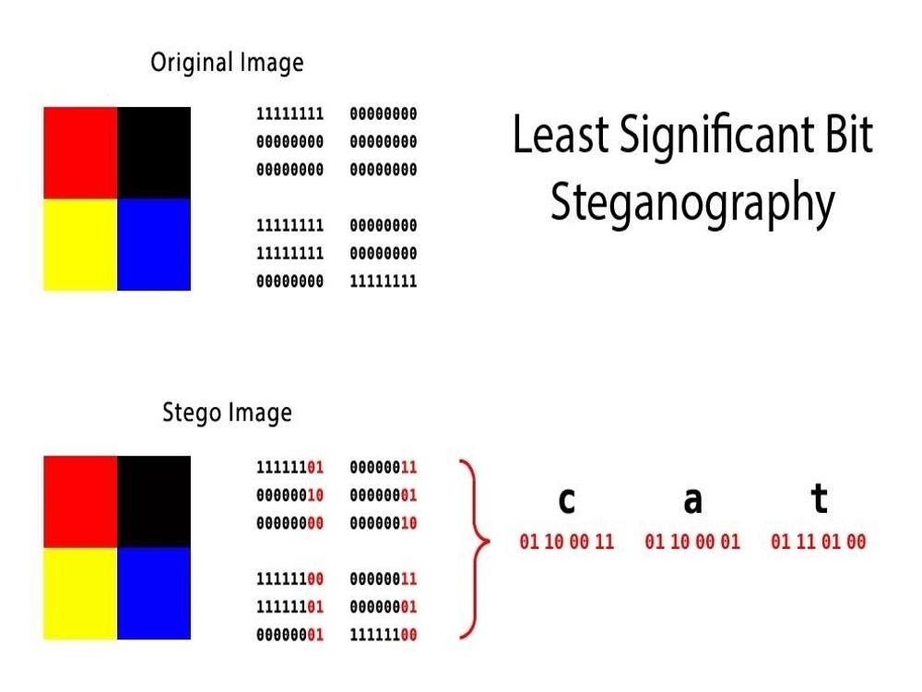
Least significant bit steganography

Slide 14
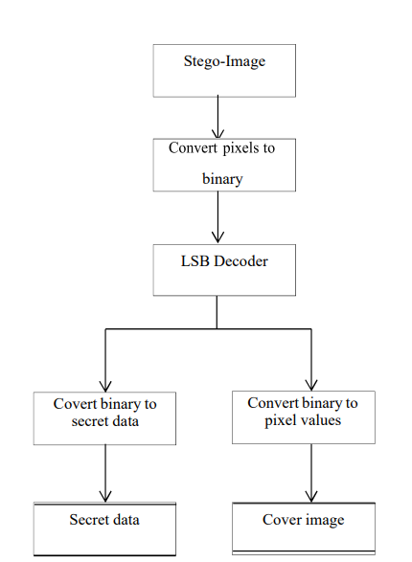
Lsb encoder
Input the stego image.
Convert the pixel value to binary representation.
Apply LSB decoder; function is to retrieve the secret data back from the stego-image.
The secret data and the cover image are separated together to get the desired output

Slide 15
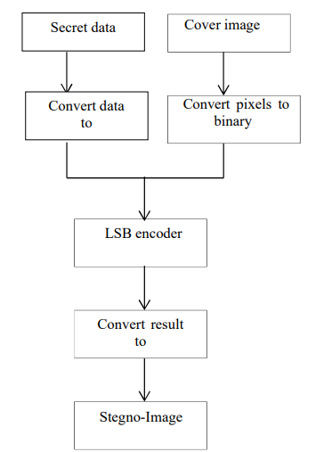
Lsb decoder
Input the secret data i.e. text or the image which needs to be hidden.
Input the cover (original) image of size [256 256]
Convert the secret data i.e. asci value of each text or pixel value in case of image into binary representation.
Convert the pixel value of cover image into binary representation.
Apply LSB encoder; function is to hide each bit of text or image into the least significant bit of each 8 pixel value of cover image.
The resultant output is converted back to pixel values to get the stego-image.

Slide 16
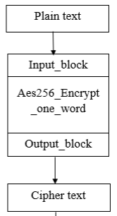
Aes encryption
All operations in AES are byte oriented. 128 bit plaintext is arranged in 4x4 matrixes with 16bytes. Substitute byte, shift rows, mix columns and add round key are the main steps in AES encryption .
Derive the set of round keys from the cipher key.
Initialize the state array with the block data (plaintext).
Add the initial round key to the starting state array.
Perform nine rounds of state manipulation.
Perform the tenth and final round of state manipulation.
Copy the final state array out as the encrypted data (ciphertext).

Slide 17
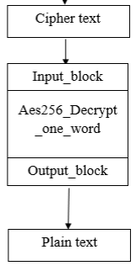
Aes decryption
Decryption is just the opposite of encryption i.e. the cipher text is converted back to the plain text. Inverse substitute byte, inverse mix column, inverse shift rows and inverse s-box takes place.
Inverse Sub Byte Transformation Each byte from the matrix is substituted with the inverse s-box table to get the new matrix.
Inverse Shift Rows Transformation The row of the matrix is circularly right shifted.
Inverse Shift Rows Transformation The row of the matrix is circularly right shifted.
Inverse Add Round Key Transformation The round keys should ted in a reverse order and Xored with the state matrix.

Slide 18
Lsb combined with aes algorithm
Our approach is to provide security for the secret information hidden inside the cover image performed through LSB technique with the help of AES algorithm.
The first step is to read the secret data and the cover image. The next step is to hide the data into the cover image which is done with the help of LSB encoder.
To protect the data from the intruder the resultant stego-image is given to AES encryption where each of the pixels get scrambled.
To get back the stego-image AES decryption is done and the output of this is provided to LSB decoder where the hidden data is retrieved finally..

Slide 19
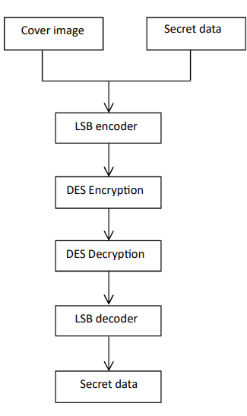
General block diagram
Read the input cover image of size [256 256].
Read the secret data i.e. text or the image.
Apply LSB encoder where the bits of the secret data are hidden into the least significant bit of the pixel value of the cover image.
The resultant stego-image is given to AES encryption in order to provide security for the hidden data.
The function of the AES decryption is to get back the stego image in order to retrieve back the data.
The LSB decoder finds each of the data which was embedded in the cover image and the resultant is the secret.

Slide 20
Diffie-hellman key exchange technique
Diffie–Hellman key exchange (DHKE) is a method of securely exchanging cryptographic keys over a public channel and was one of the first public-key protocols as conceived by Ralph Merkle and named after Whitfield Diffie and Martin Hellman.

Slide 21
WORKING OF dhke
Setup: Both parties, usually referred to as Alice and Bob, agree on a public domain parameters. These parameters include a large prime number (p) and a generator (g) that is also a primitive root modulo p. These parameters are known to both parties.
Key Generation: a. Alice selects a random secret number, a, and computes A = g^a mod p. She then sends A to Bob. b. Bob selects a random secret number, b, and computes B = g^b mod p. He then sends B to Alice.
Key Exchange: a. Alice receives B from Bob and computes the shared secret key as K = B^a mod p. b. Bob receives A from Alice and computes the shared secret key as K = A^b mod p.
Key Derivation: Both Alice and Bob now have the same shared secret key, K, which can be used for symmetric encryption or any other cryptographic purposes.

Slide 22
Dhke EXAMPLE
Alice and Bob agree on the prime number P = 23 and the generator G = 7.
Alice chooses a private key a = 3, and Bob chooses a private key b = 6.
Alice computes her public key x = G^a mod P = (7^3 mod 23) = 21.
Bob computes his public key y = G^b mod P = (7^6 mod 23) = 4.
Alice sends her public key x to Bob.
Bob sends his public key y to Alice.
Alice computes the shared secret key k_a = y^a mod P = (4^3 mod 23) = 18.
Bob computes the shared secret key k_b = x^b mod P = (21^6 mod 23) = 18.
Alice and Bob now have the same shared secret key, which they can use to encrypt and decrypt messages.

Slide 23
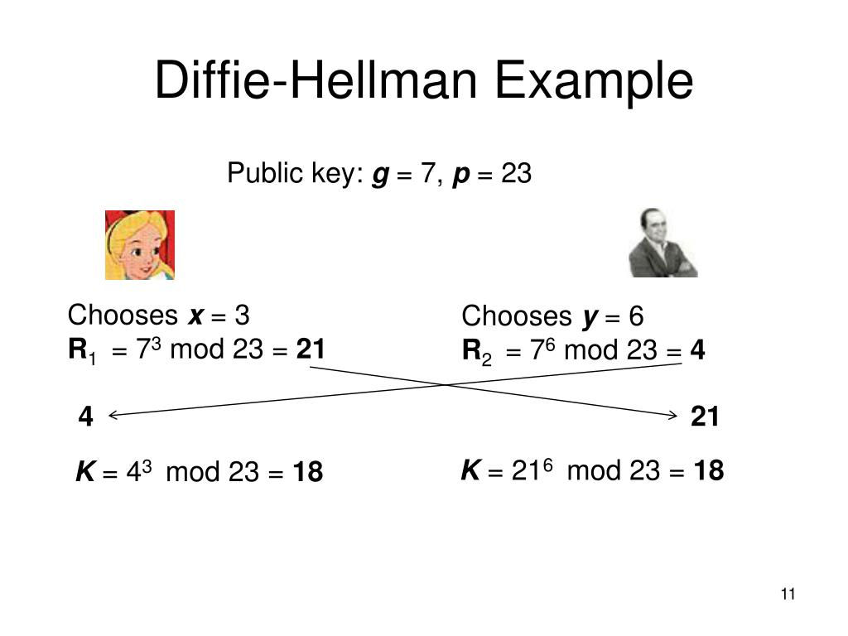

Slide 24
Encoded pixel values
Encoded pixel values refer to pixel values that have been modified or encoded to contain additional information. This encoding is commonly used in image steganography or data hiding techniques to conceal data within the pixel values of an image.
In image steganography, the original pixel values are altered in a way that allows the hidden information to be stored within the image without significantly affecting its visual appearance.
This can be achieved by modifying certain lowest significant bits of the pixel values while ensuring that the changes are imperceptible to the human eye.

Slide 25
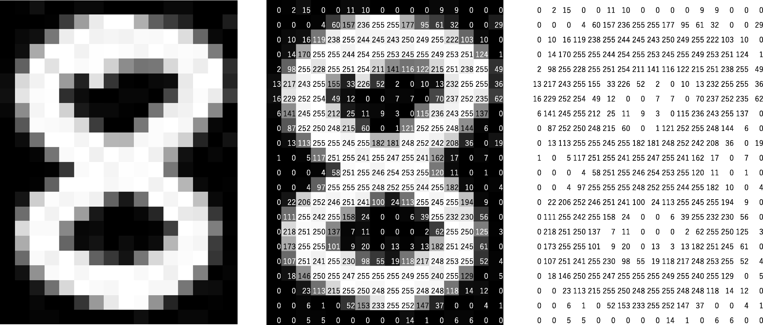
This is an example showing that how the pixels are arranged in the image where the lowest bits are used to hide the secret message.

Slide 26
Metrics used
MSE Value:
Mean squared error (MSE) is a measure of the average squared difference between the actual and predicted values. It is a common metric used to evaluate the performance of regression models. The lower the MSE, the better the model is at predicting the actual values.
Image Quality | MSE
Very poor | 100
Poor | 50
Fair | 25
Good | 12.5
Excellent | 6.25

Slide 27
Cont’d
PSNR Value:
Peak signal-to-noise ratio (PSNR) is a measure of the quality of a reconstructed image. It is calculated as the ratio of the maximum possible signal power to the power of the noise in the reconstructed image. A higher PSNR indicates a better quality image.
Image Quality | PSNR (dB)
Very poor | 20
Poor | 30
Fair | 40
Good | 50
Excellent | 60

Slide 28
Cont’d
RGB Pixel Value:
The RGB value of a pixel represents the intensity of the red, green, and blue color channels that make up the pixel's color.
Each color channel is typically represented by an 8- bit value ranging from 0 to 255, where 0 represents no intensity (no color) and 255 represents full intensity (maximum color).
In an RGB image, each pixel is composed of three values: the red (R), green (G), and blue (B) color channels.
These values define the contribution of each color channel to the overall color of the pixel. For example, a pixel with an RGB value of (255, 0, 0) represents full intensity red, as the red channel is at its maximum value (255) which is shown in the next slide.

Slide 29



Pixel with RGB value of (255, 0, 0)
Pixel with RGB value of (0,0,255)
Pixel with RGB value of (0,255,0)

Slide 30
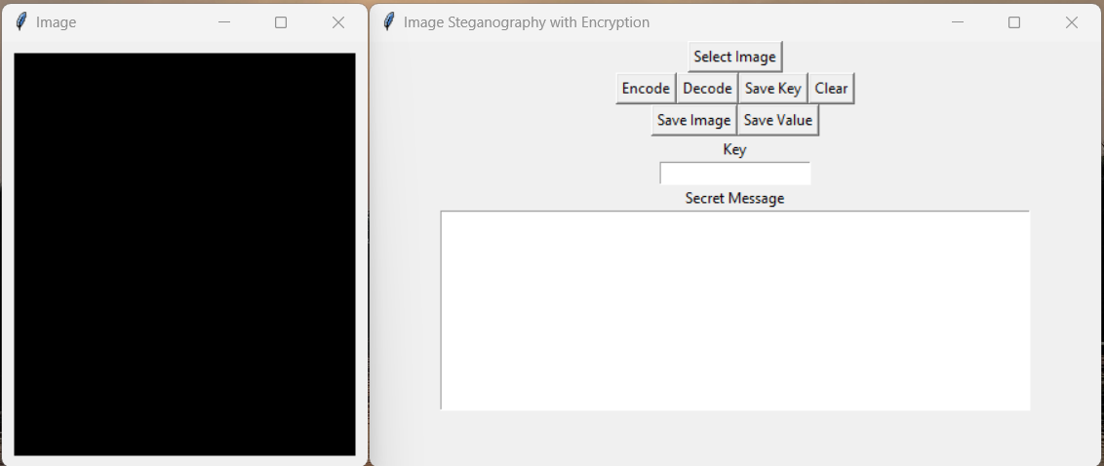
Experimental results
User interface of the project.

Slide 31
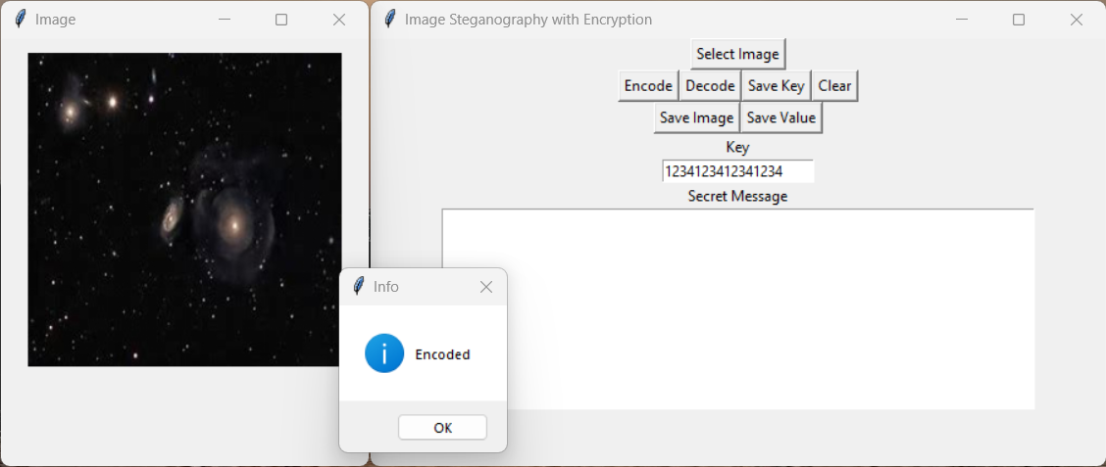
After the message is encoded in the cover image.

Slide 32
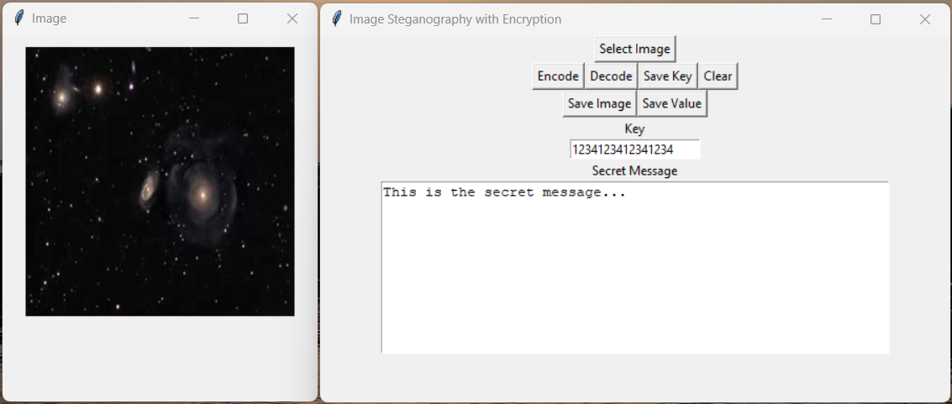
After the message is decoded.

Slide 33
applications
Military applications.
Secure communication.
Quality control.
Copyright protection.

Slide 34
ADVANTAGES
DISADVANTAGES
Secure transfer of data.
Negligible chance of decoding when caught.
Permanent and consistent.
Compatibility.
Vulnerability to statistical analysis.
Limited embedding capacity.
Chances to misuse.

Slide 35
conclusion
In this work, we used LSB technique in order to hide the secret data. Further in order to protect the data AES algorithm is applied with the maximum key length of 256 bit. Image steganography is implemented in Visual Studio Code software using Python. Images of size 256 X 256 are used. Using the above two algorithms, we have hidden the text inside the cover image and is also successful in retrieving back the hidden data, and the RGB values of each pixel in an image is extracted successfully and it is saved for the later verification. Diffie–Hellman key exchange (DHKE) gives double layer security to the project

Slide 36
Future work
For further study the AES algorithm can be added with some other steganography techniques like audio or video steganography.
One additional encryption algorithm like RSA can be added for additional security.

Slide 37
references
Shahid Rahman, Jamal Uddin, Habib Ullah Khan, Hameed Hussain, Ayaz Ali Khan, and Muhhamad Zakarya “A Novel Steganography Technique for Digital Images Using the Least Significant Bit Substitution Method”,2022.
U. A. Md. Ehsan Ali, Emran Ali, Md. Sohrawordi and Md. Nahid Sultan “A LSB Based Image Steganography Using Random Pixel and Bit Selection for High Payload”, 2021.
Lalit Kumar Gupta, Aniket Singh, Abhishek Kushwaha, and Ashish Vishwakarma, “Analysis of Image Steganography Techniques for Different Image Format”, 2021,
Arshiya S. Ansari, Mohammad S.Mohammadi, and Mohammad Tanvir Parvez” A MultipleFormat Steganography Algorithm for Color Images,”2020.

Slide 38
Cont’d
Ali Ahmed and Abdelmotalib Ahmed “A Secure Image Steganography using LSB and Double XOR Operations” IJCSNS International Journal of Computer Science and Network Security, VOL.20 No.5, May 2020.
Arun Kumar Singh, “Steganography in Digital Images Using LSB Technique”, Journal of Xidian University 2020.
Mr. Jawwad A R. Kazi, Mr. Gunjan N. Kiratkar, Ms. Sonali S. Ghogale, Prof. Atiya R. Kazi “A novel approach to Steganography using pixel-based algorithm in image hiding”, 2020 International Conference on Computer Communication and Informatics,2020.
Sakshi Audhi, Maruska Mascarenhas “Secure Mechanism for Communication Using Image Steganography” 2019 2nd International Conference on Intelligent Computing, Instrumentation and Control Technologies (ICICICT).
NIST, “Advanced Encryption Standard,” http://csrc.nist.gov/ publications/fips/fips197/fips197.pdf, 2001 (accessed March 24, 2017).

Slide 39
Cont’d
Jemima Dias, Dr. Ajit Danti “Image Steganography based Cryptography”,2020 International Journal of Scientific & Engineering Research.
Z. Y. Al-Omari and A. T. AlTaani, “Secure LSB steganography for coloured images using character-colour mapping,” 2017 8th International Conference on Information and Communication Systems (ICICS), 2017, pp. 104-110.
Beenish Siddiqui, Sudhir Goswami “A Survey on Image Steganography Using LSB Substitution Technique” 2017 International Research Journal of Engineering and Technology (IRJET).
Aman Arora, Manish Pratap Singh, Prateek Thakral, Naveen Jarwal proposed a paper by name “Image steganography using Enhanced LSB substitution technique”,2016 fourth international conference on Parallel, Distributed and Grid Computing.

Slide 40

THANK YOU
Any queries….?

